Slide 1
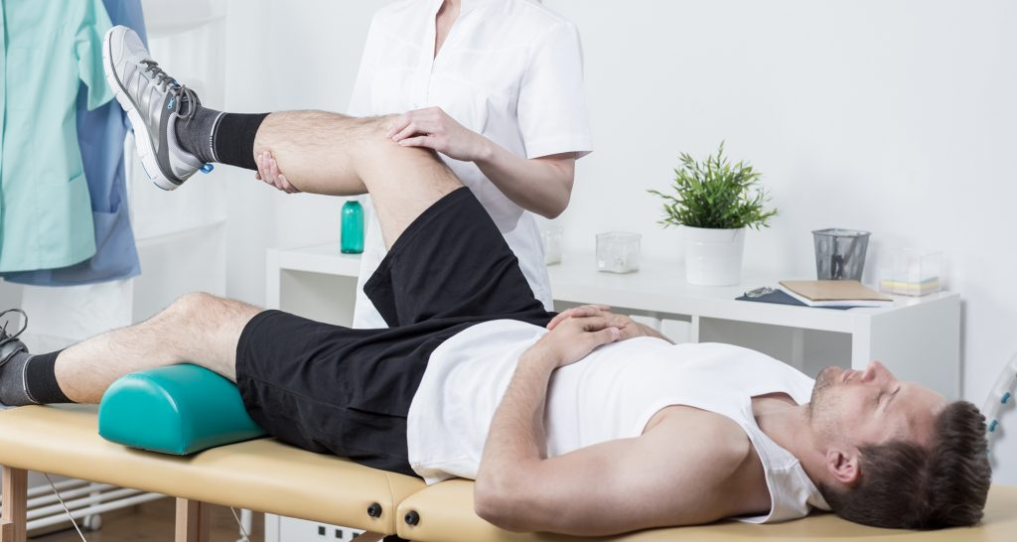
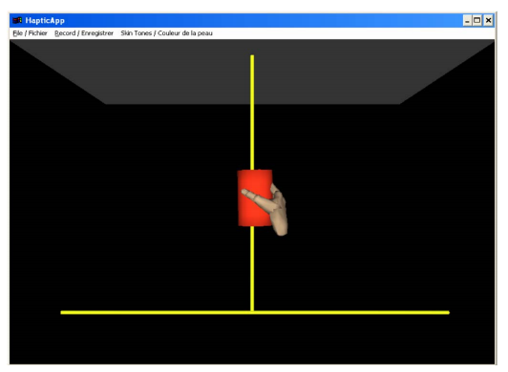
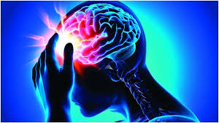
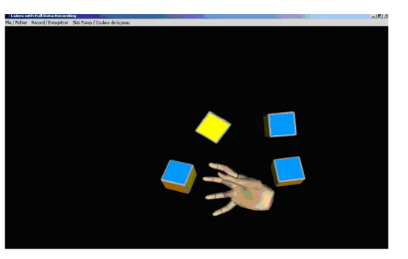
Haptic Virtual Rehabilitation Exercises for Poststroke Diagnosis
DONE BY FERRIN DSOUZA 4SO17CS038

Slide 2

Objectives
Know what I am talking about somewhat i.e. breakdown of the topic.
Review related work in the field of haptic virtual rehabilitation and highlight how our work is differentiated from others.
Introduces the designed framework and its software architecture.
The five task-oriented exercises are described.
Elaborate the quantitative diagnosis analysis to evaluate the patient’s state using the recorded haptic data.
Conclusion.

Slide 3
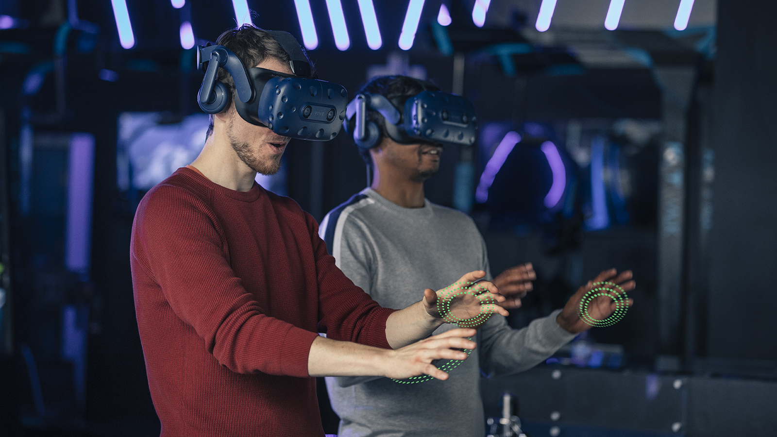
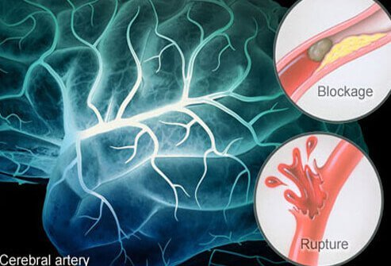
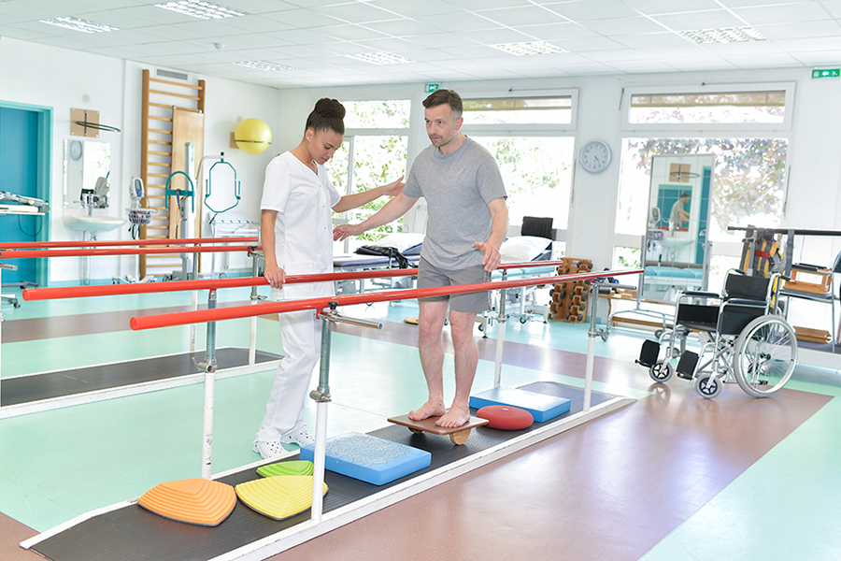
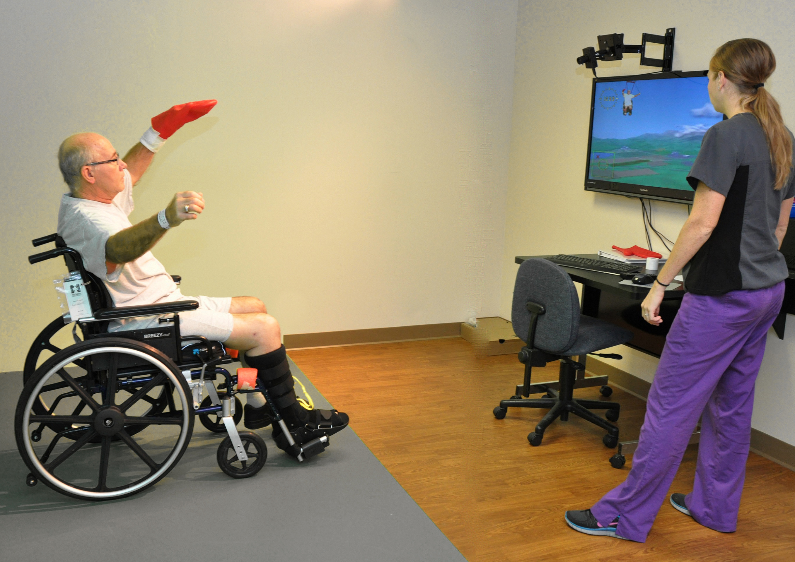
What is Haptic Virtual Rehabilitation Exercises for Poststroke Diagnosis ?
Haptic-based systems enable a user to manipulate objects in virtual environments in a natural and effective way and can provide information which cannot be completely described with visual or audio feedback, such as stiffness, texture, or weight of objects.
The use of game-based features into virtual environments has been reported to enhance motivation during therapy. Moreover, auditory and performance feedback can help patients be motivated.

Slide 4
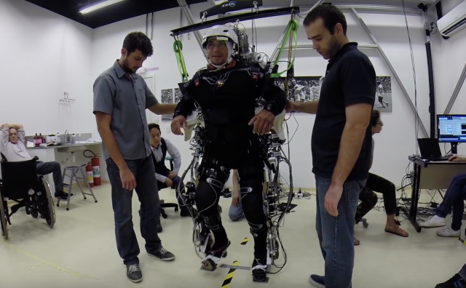
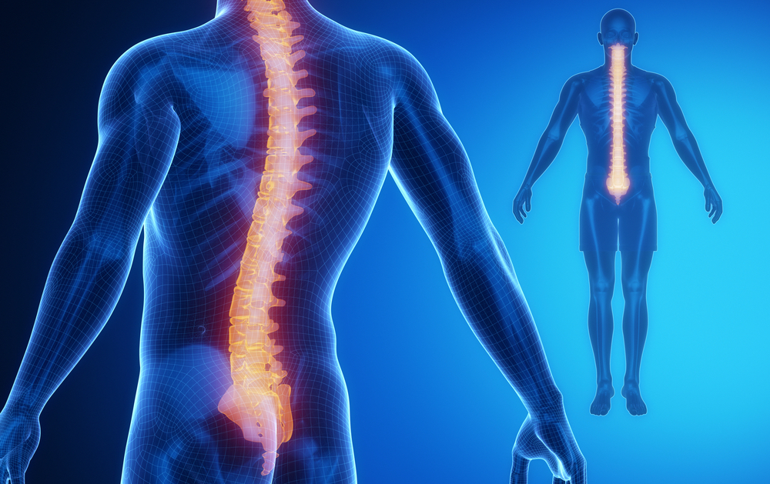
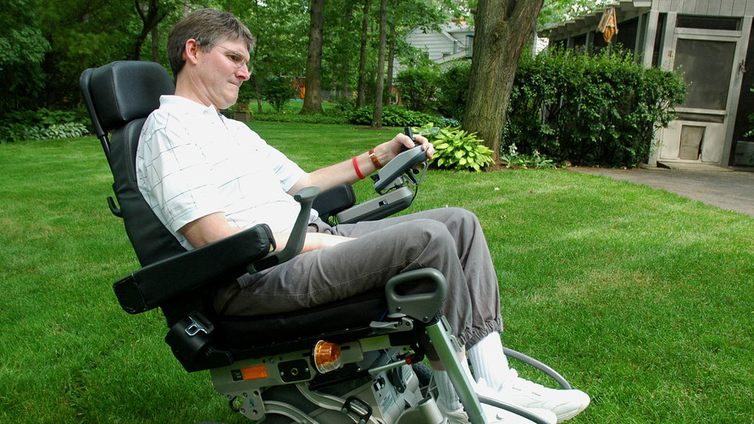
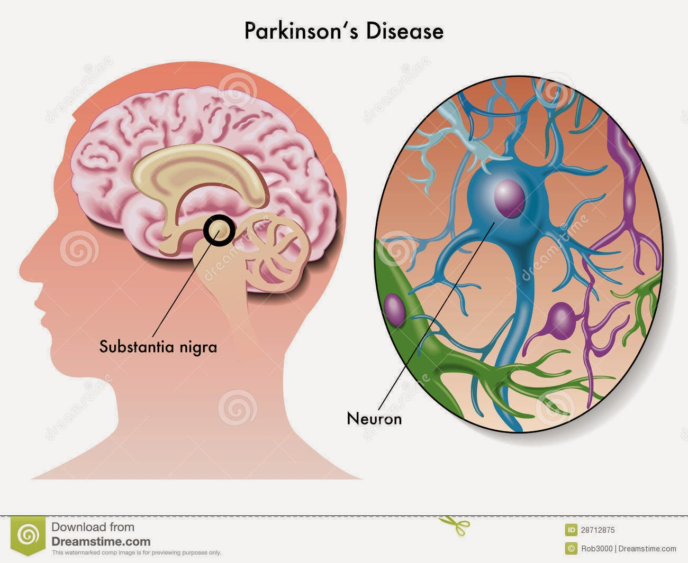
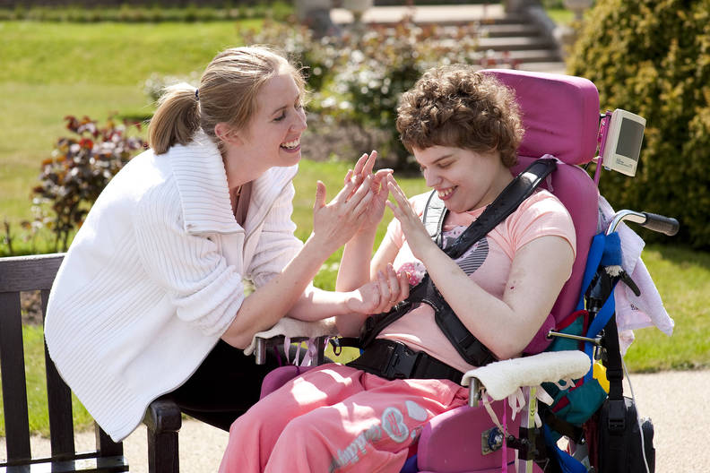
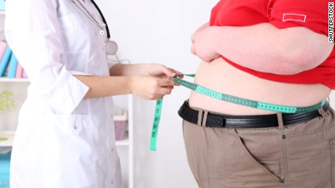
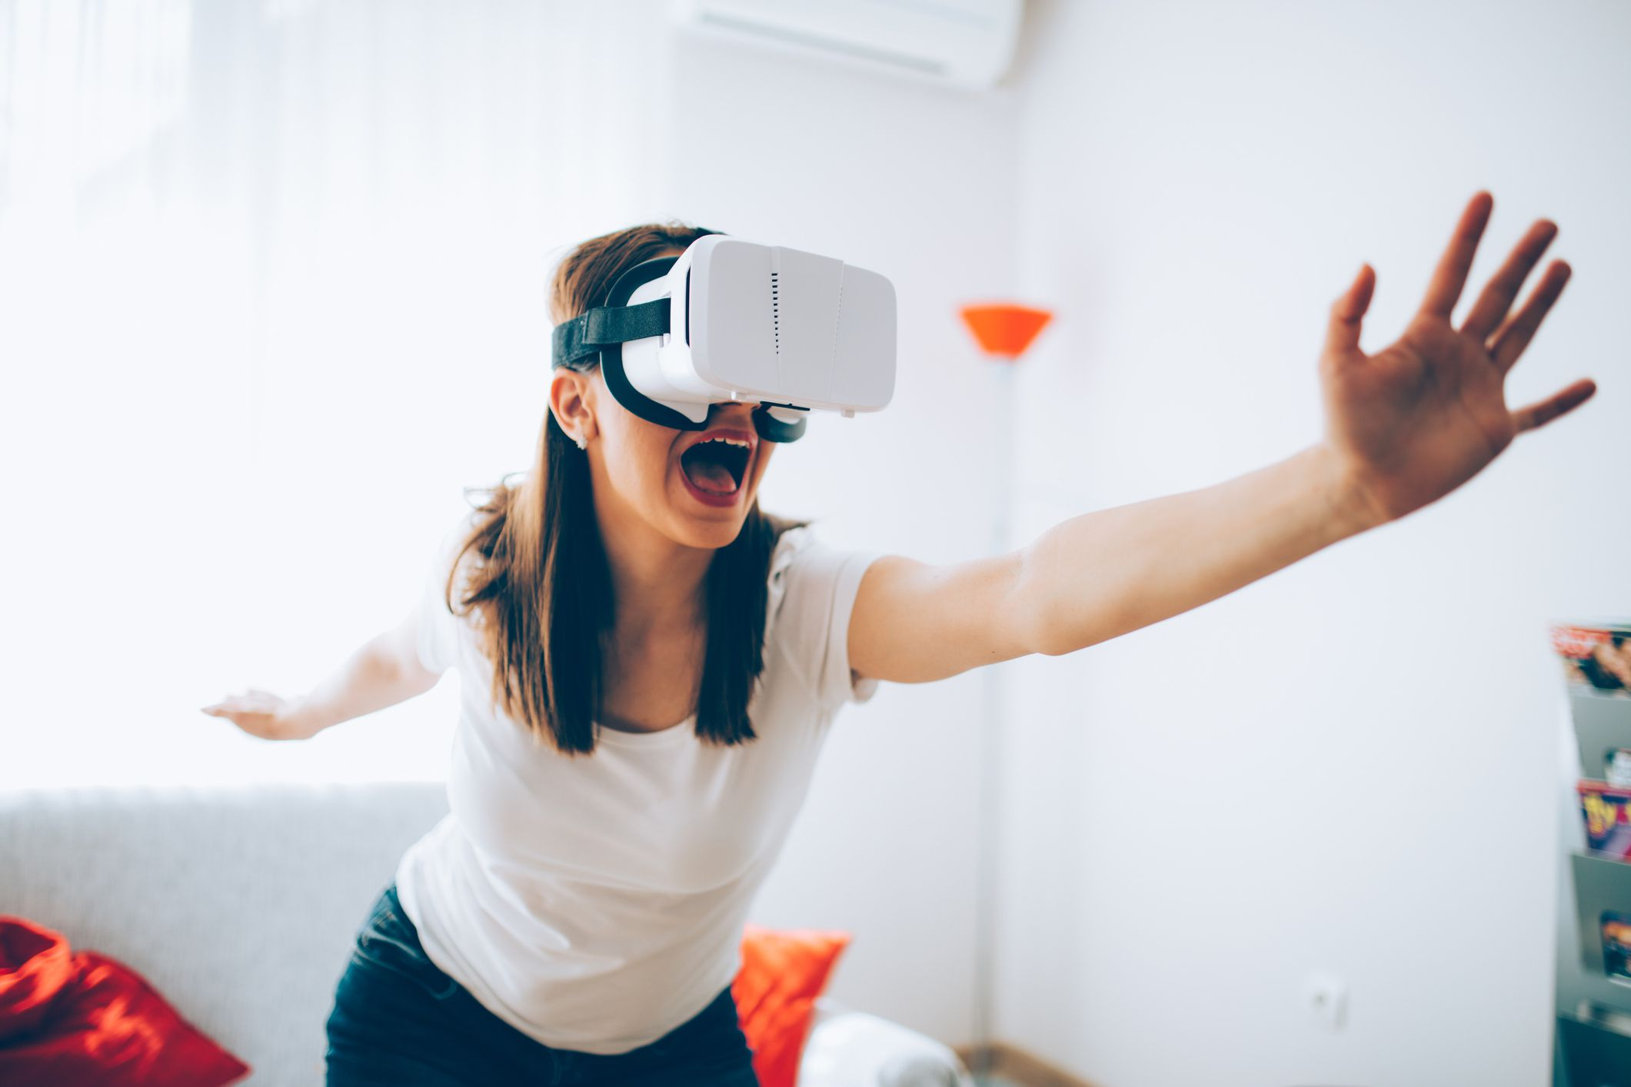



related work

Slide 5
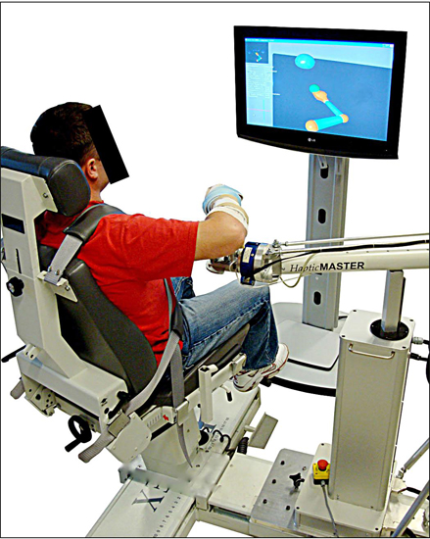

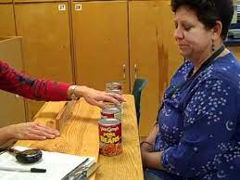
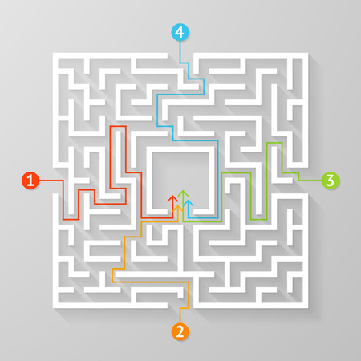
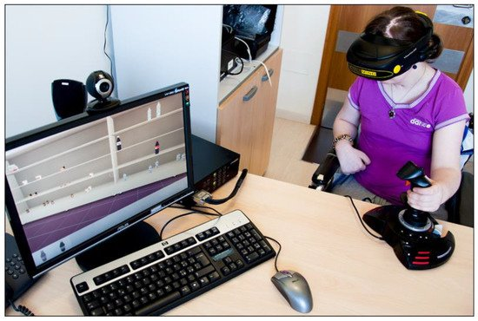
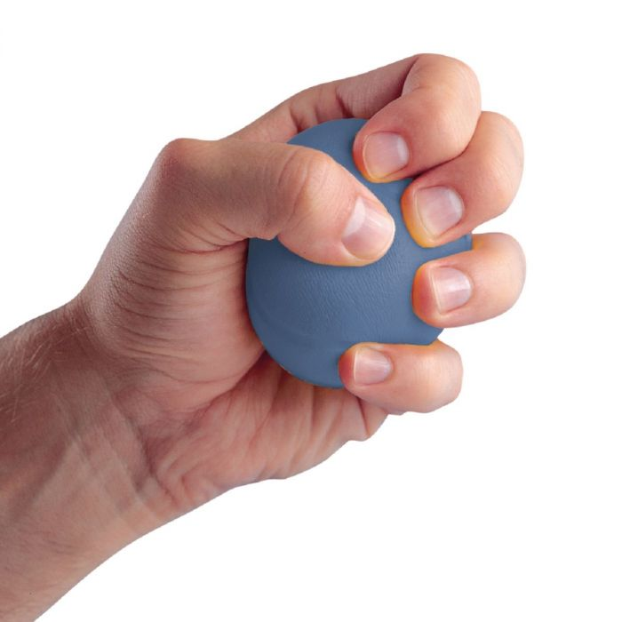
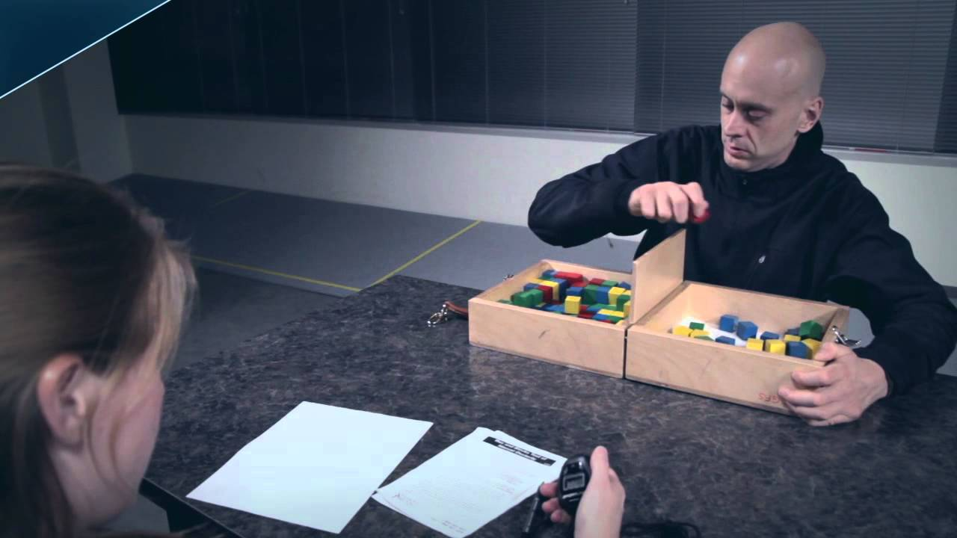
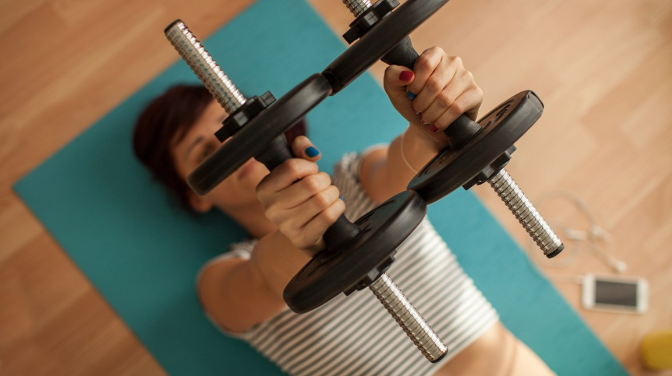
related work

Slide 6
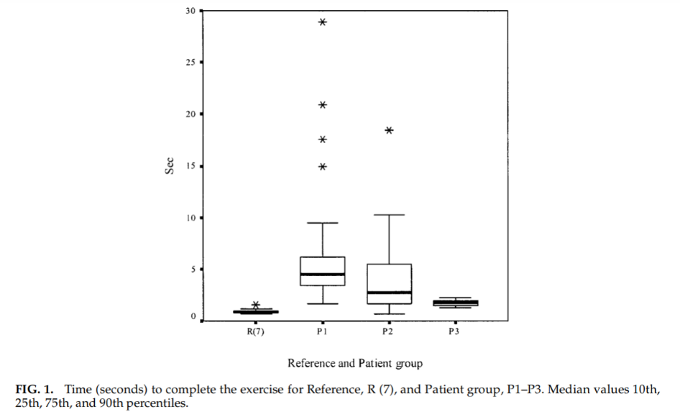
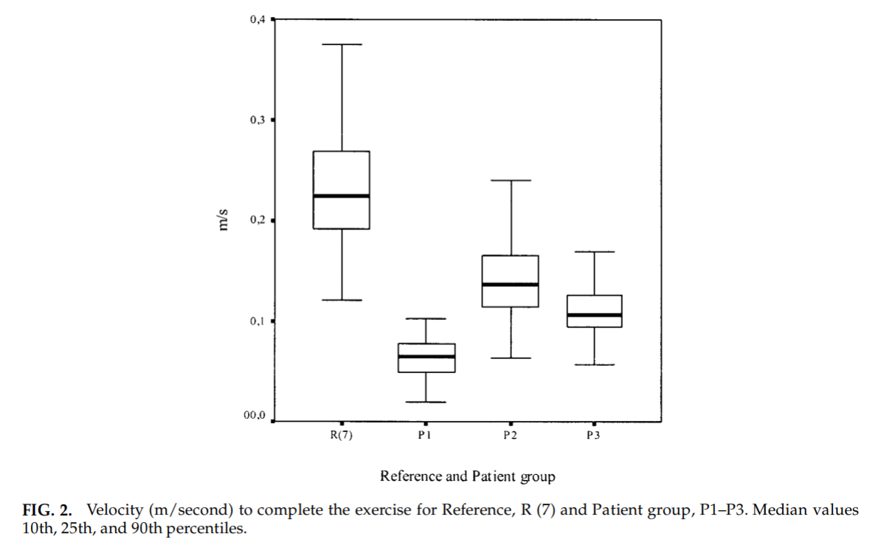
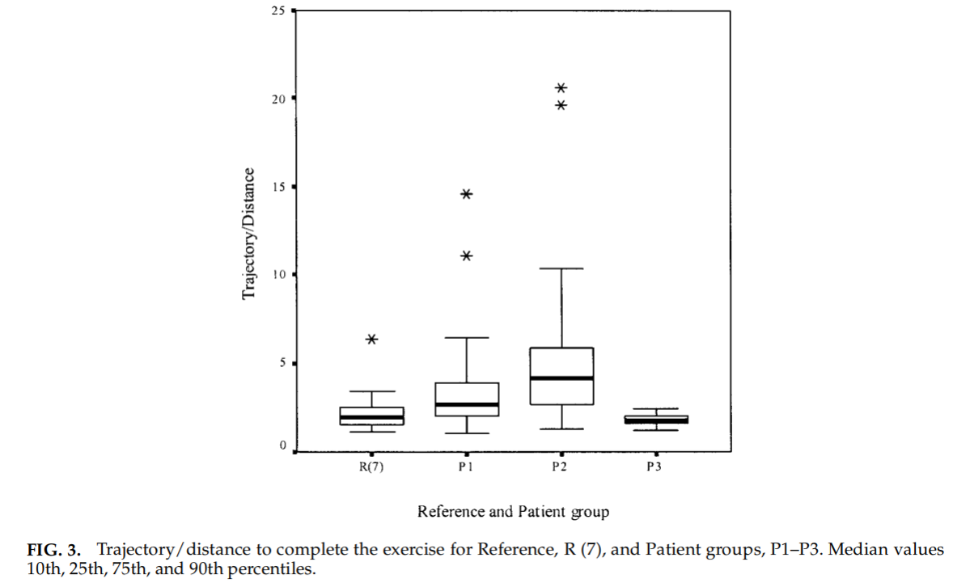
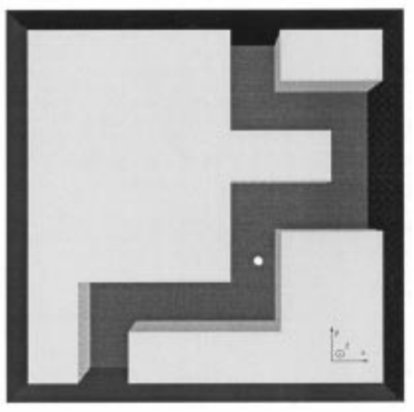
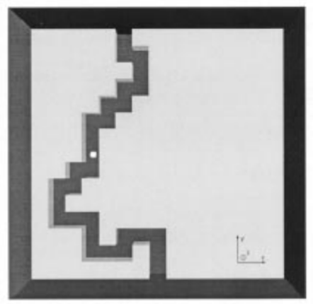
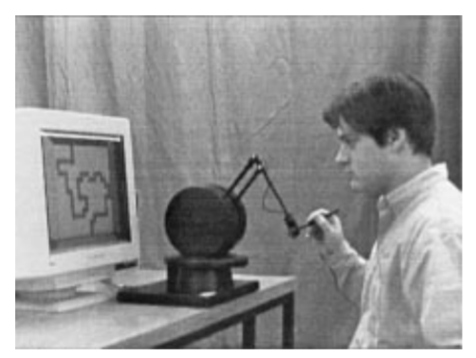
related work

Slide 7
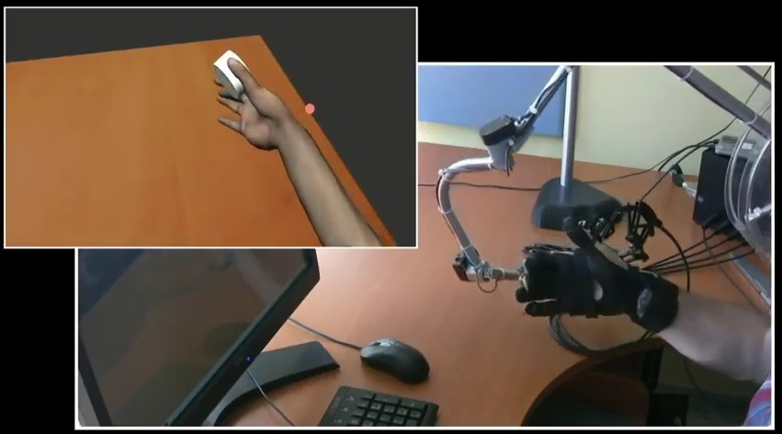
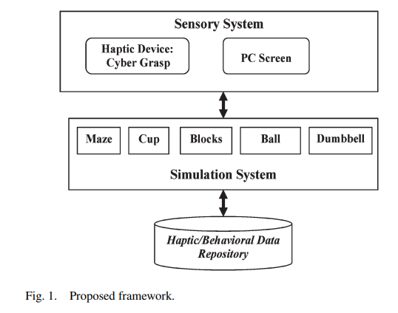
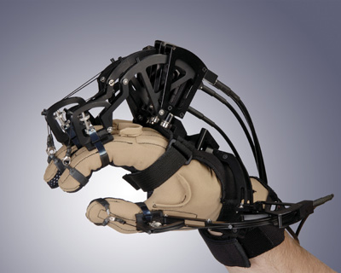
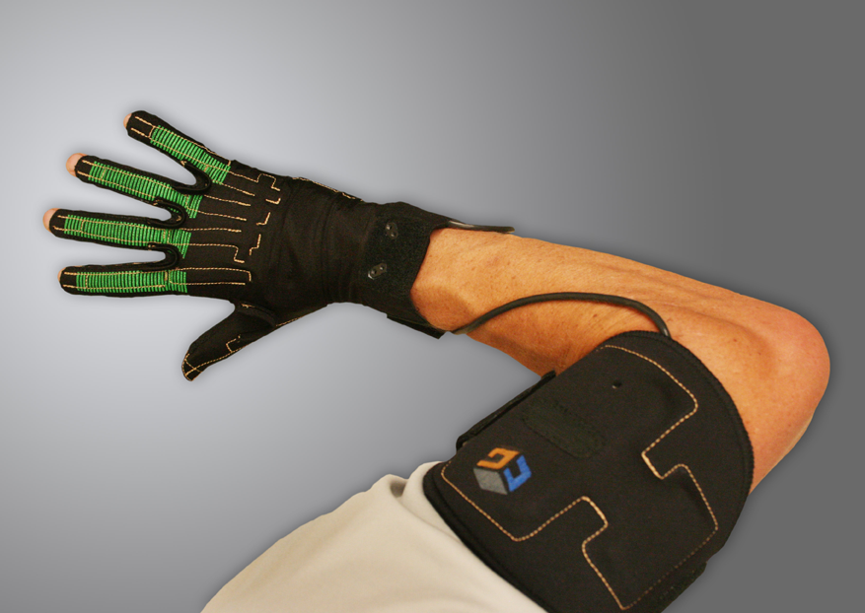
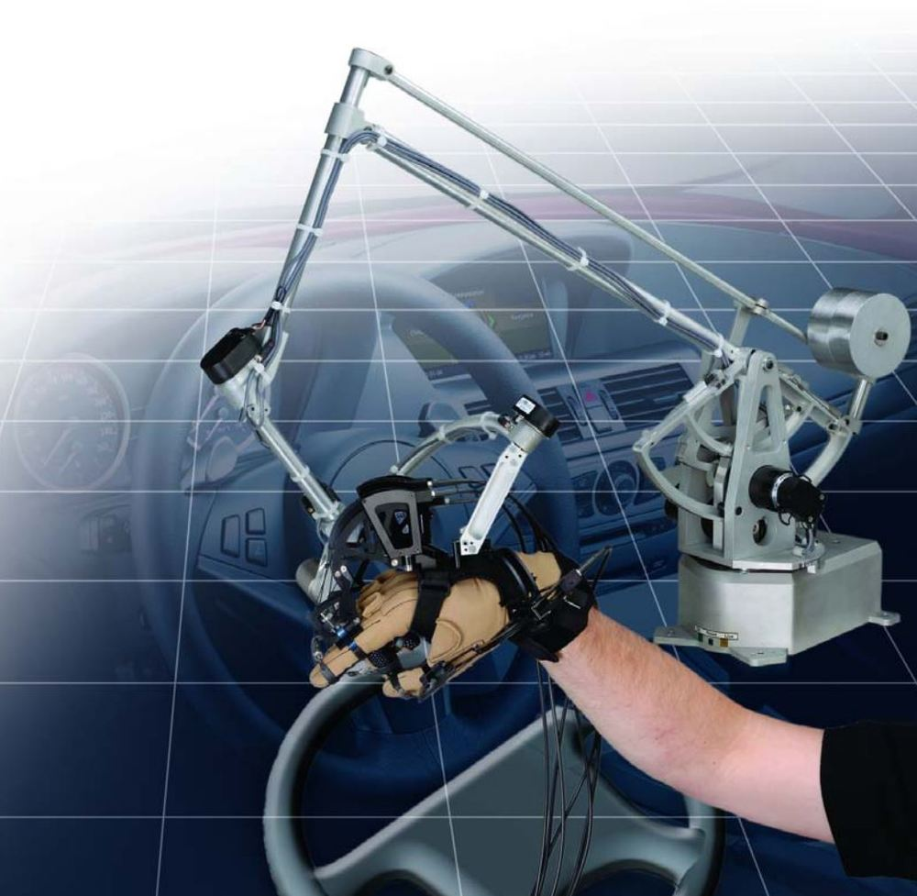
System components

Slide 8
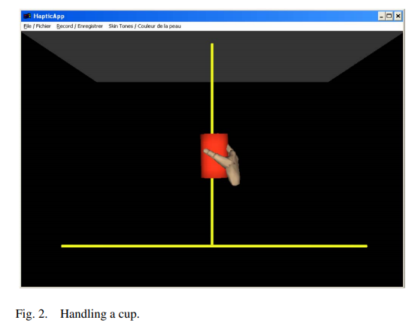
Exercise description
Handling A Cup

Slide 9
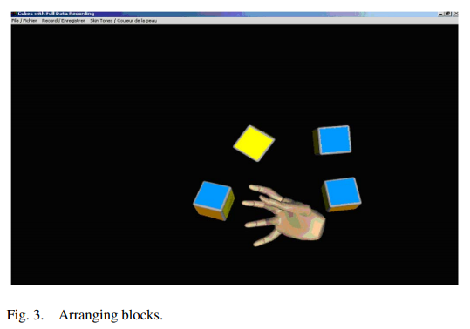
Exercise description
B. Arranging Blocks

Slide 10
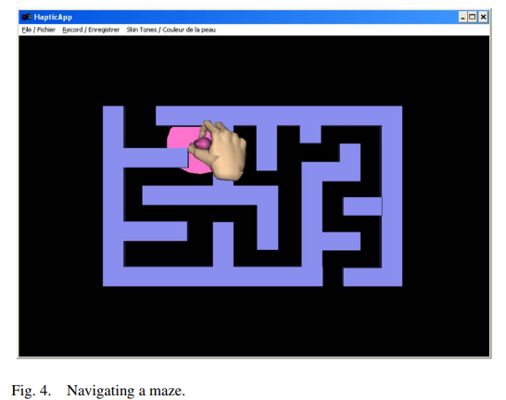
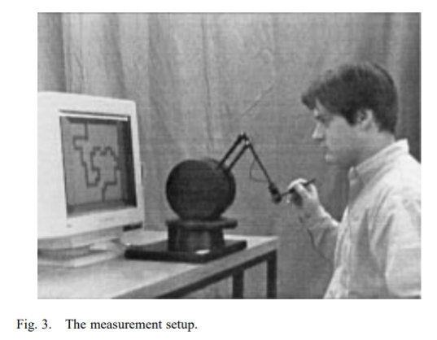
Exercise description
C. Navigating A Maze

Slide 11
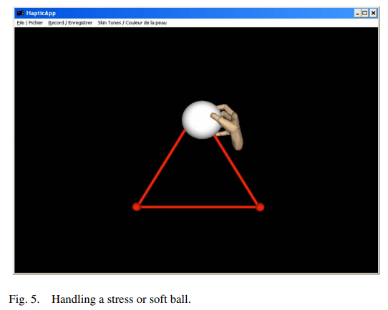
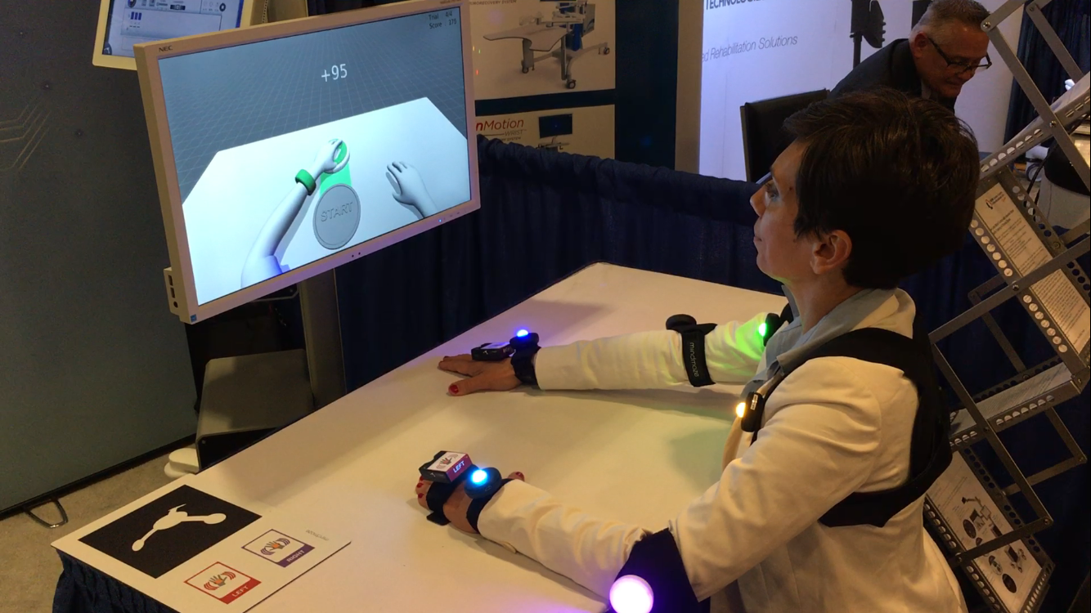
Exercise description
D. Squeezing A Ball

Slide 12
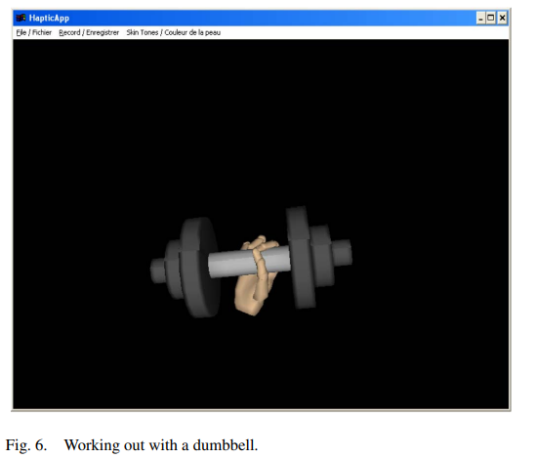
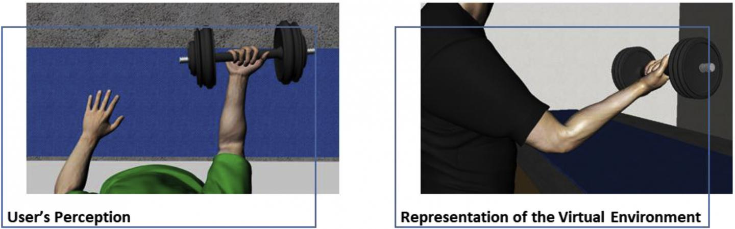
Exercise description
E. Dumbbell

Slide 13
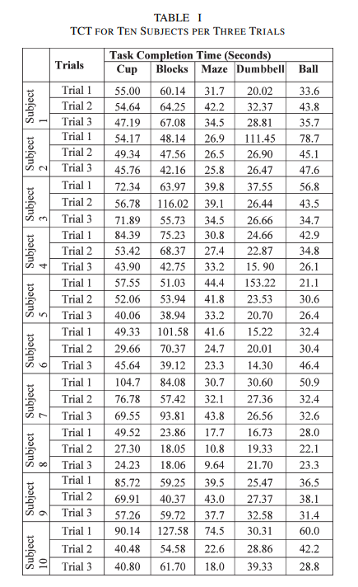
Performance evaluation

Slide 14
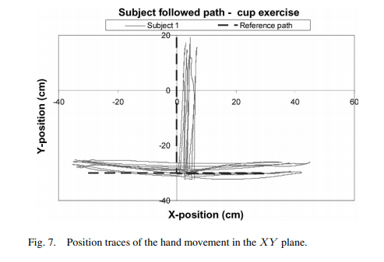
Performance evaluation
Handling A Cup

Slide 15
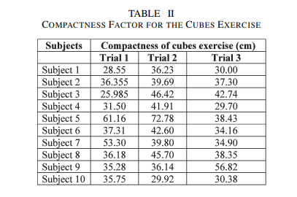
Performance evaluation
B. Arranging Blocks

Slide 16
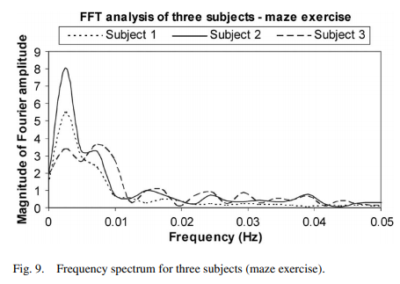
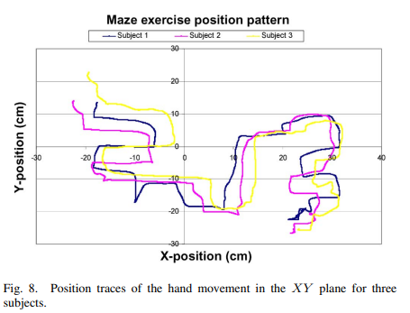
Performance evaluation
C. Navigating A Maze

Slide 17
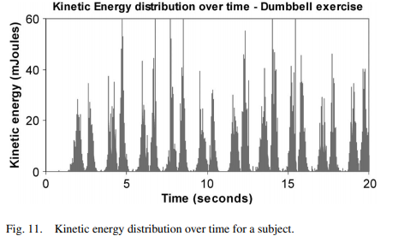
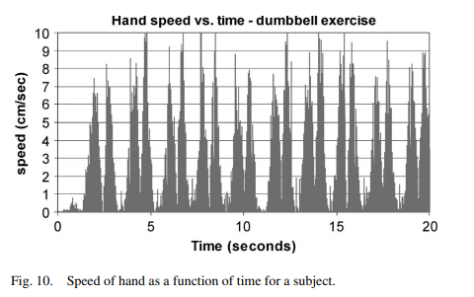
Performance evaluation
D. Dumbbell

Slide 18
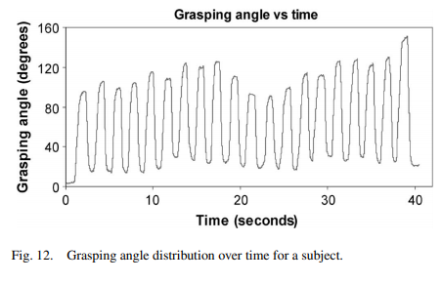
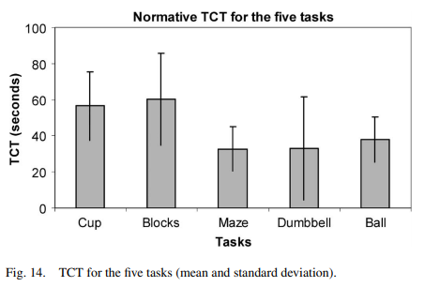


Performance evaluation
E. Squeezing A Ball

Slide 19

Recently, many research efforts have been put to overcome the current limitations of the haptic hardware technologies for rehabilitation applications.
Despite the limitations of state-of-the-art haptic devices, a huge set of interaction data can be captured and analyzed to derive reference “golden” metrics for normal healthy subjects.
The long-term objective is to develop a Decision Support System, whereby OTs at clinics can evaluate a patient’s performance of exercises carried out at home and accordingly adapt tasks based on the patient’s current capacity.
Although this paper shows the feasibility of this system, further research must be done to get clinically meaningful, consistent, and reliable normative data. We plan to test this framework with 50 normal subjects to derive normative data as a reference metrics to evaluate the patient’s progress. Eventually, we plan to examine the system with stroke patients and examine the effectiveness of the system as a diagnosis tool.

Slide 20





credit where its due
Atif Alamri
Mohamad Eid
Rosa Iglesias
Abdulmotaleb El Saddik
Shervin Shirmohammadi

Slide 21
[1] F. D. Rose, B. M. Brooks, and A. A. Rizzo, “Virtual reality in brain damage rehabilitation: Review,” CyberPsychol. Behav., vol. 8, no. 3, pp. 241– 262, Jun. 2015.
[2] M. Holden, “Virtual environments for motor rehabilitation: Review,” CyberPsychol. Behav., vol. 8, no. 3, pp. 187– 211, Jun. 2015.
[3] G. Riva, “Virtual reality in psychotherapy: Review,” CyberPsychol. Behav., vol. 8, no. 3, pp. 220–230, Jun. 2016
[4] D. Jack, R. Boian, A. Merians, M. Tremaine, G. Burdea, S. Adamovich, M. Recce, and H. Poizner, “Virtual realityenhanced stroke rehabilitation,” IEEE Trans. Neural Syst. Rehabil. Eng., vol. 9, no. 3, pp. 308–318, Sep. 2016.
[5] M. McLaughlin, A. A. Rizzo, Y. Jung, W. Peng, S. Yeh, and W. Zhu, “Haptics-enhanced virtual environments for stroke rehabilitation,” Proc. IPSI, Cambridge, MA, 2015.
[6] J. Broeren, M. Georgsson, M. Rydmark, and K. S. Sunnerhagen, “Virtual reality in stroke rehabilitation with the assistance of haptics and telemedicine,” in Proc. 4th Int. Conf. Disability, Virtual Reality Associated Technol., Veszprém, Hungary, 2016, pp. 71–76.
[7] R. P. Paranjape, M. J. Johnson, and B. Ramachandran, “Assessing impaired arm use and learned bias after stroke using unimanual and bimanual steering tasks,” in Proc. IEEE EMBS Annu. Int. Conf., New York, 2015, pp. 3958– 3961.
[8] I. Shakra, M. Orozco, A. El Saddik, S. Shirmohammadi, and E. Lemaire, “Haptic instrumentation for physical rehabilitation of stroke patients,” in Proc. IEEE Int. Workshop Med. Meas. Appl., Benevento, Italy, Apr. 2016, pp. 98–102.
[9] I. Shakra, M. Orozco, A. El Saddik, S. Shirmohammadi, and E. Lemaire, “VR-based hand rehabilitation using a haptic-based framework,” in Proc. 23rd IEEE Instrum. Meas. Technol. Conf., Sorrento, Italy, Apr. 2016, pp. 1178– 1181.

